Slide 1
Matrix Algebra
2.7 Dimension and Rank
Bumhee Cho

Slide 2





Basis for a Subspace
H = Span{u, v}
w
Span{u, v, w}
Span{u, v, w, ...}
A basis for a subspace H of ℝ^{n} is a linearly independent set in H that spans H
Notes:
u,v여도 되고, v,w여도 되고 independent set 이기만 하면된다.

Slide 3





Coordinate Systems
H
x

Slide 4

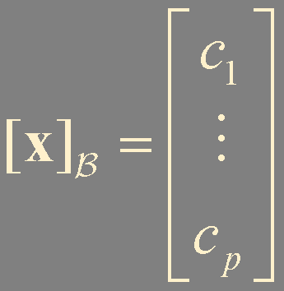

Coordinates and Coordinate Vector
Suppose the set B = {b₁,…, b_{p}} is a basis for a subspace H
For each x in H, the coordinates of x relative to the basis B are the weights c₁, … , c_{p} such that
is called the coordinate vector of x (relative to B) or the B-coordinate vector of x.

Slide 5
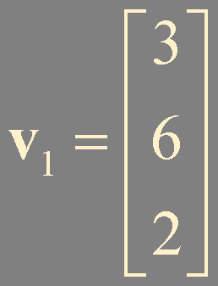
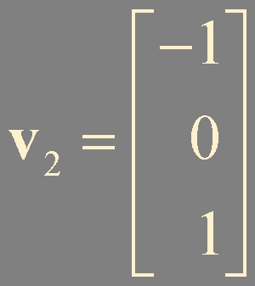
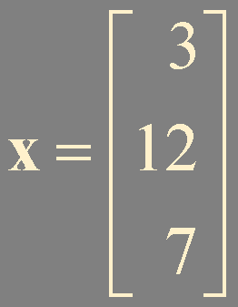

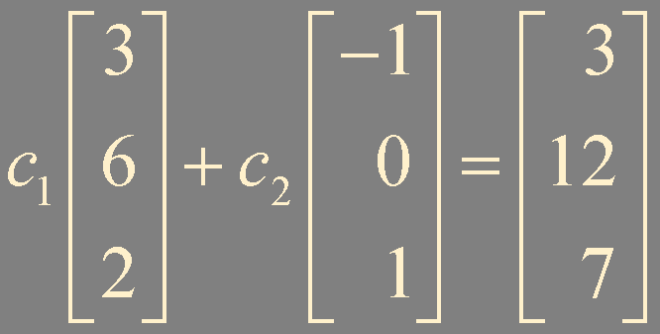
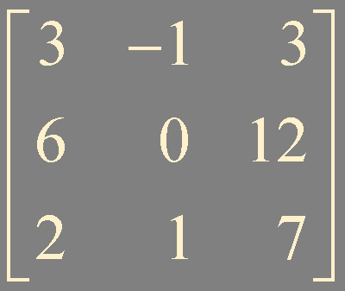

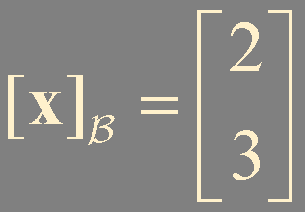

Example 1.
H = Span{v₁,v₂}
H is isomorphic to ℝ²
x = 2v₁ + 3v₂
v₂
is one-to-one
v₁

Slide 6
Dimension
The dimension of a nonzero subspace H, denoted by dim H,
is the number of vectors in any basis for H
The dimension of the zero subspace {0} is defined to be zero.
ℝ³
A plane through 0 in ℝ³ is two-dimensional
A line through 0 in ℝ³ is one-dimensional

Slide 7
Rank
The rank of a matrix A, denoted by rank A,
is the dimension of the column space of A

Slide 8
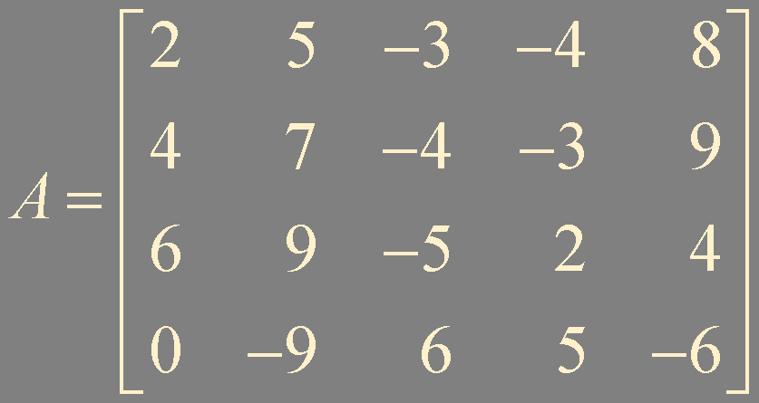
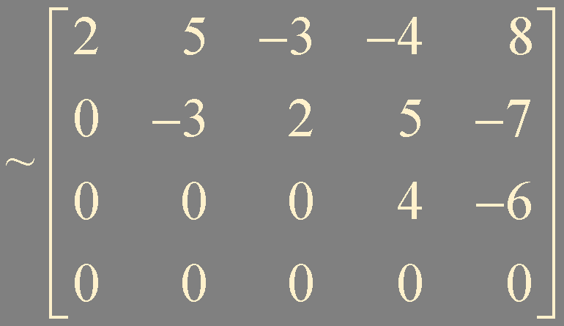
Example 2. Determine rank A and dim Nul A
rank A = 3
dim Nul A = 2
x₃u + x₅v

Slide 9
Theorem 13. The Rank Theorem
If a matrix A has n columns, then rank A + dim Nul A = n

Slide 10
Theorem 14. The Basis Theorem
Let H be a p-dimensional subspace of ℝ^{n}
Any linearly independent set of exactly p elements in H is automatically a basis for H
Also, any set of p elements of H that spans H is automatically a basis for H
If p elements are linearly dependent, the number of pivots in A is less than p. Some b in H is not in Col A
b
Col A
H
Notes:
H를 Span 하기위한 최소 vector의 개수는 p개가 되어야한다. 이 경우엔, vector들이 linearly independent하다.
즉, p개의 vector들이 H를 span하고 있다면 이들은 linearly independent set이고 H의 basis이다.

Slide 11
Theorem. The Invertible Matrix Theorem (continued)
Let A be an invertible n × n matrix. Then the following statements are equivalent.
m. The columns of A form a basis of ℝ^{n}
n. Col A = ℝ^{n}
A is an invertible matrix
There is an n × n matrix C such that CA = I
The equation Ax = 0 has only the trivial solution
A has n pivot positions
A is row equivalent to the identity n × n matrix
There is an n × n matrix D such that AD = I
The equation Ax = b has at least one solution for each b in ℝ^{n}
The columns of A span ℝ^{n}
The linear transformation x ↦ Ax maps ℝ^{n} onto ℝ^{n}
The columns of A form a linearly independent set
The linear transformation x ↦ Ax is one-to-one
A^{T} is an invertible matrix
o. dim Col A = n
p. rank A = n
q. dim Nul A = 0
r. Nul A = {0}

Slide 12
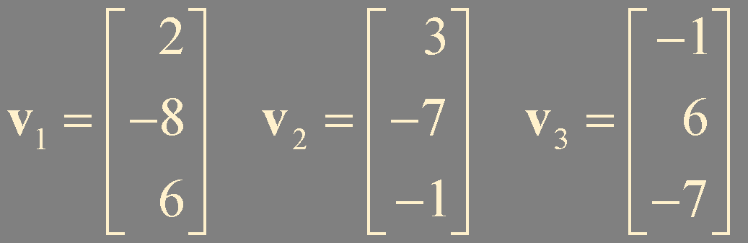
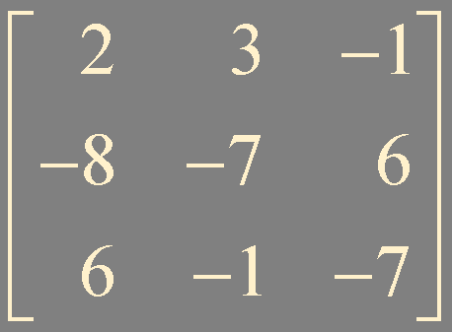
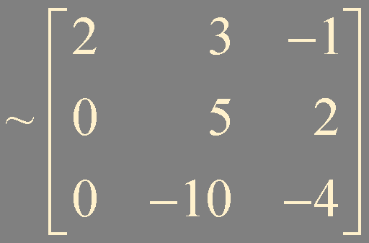
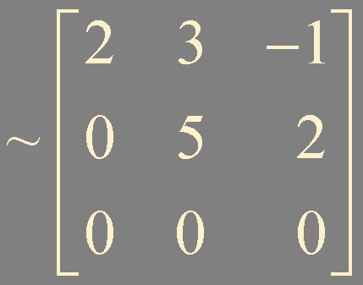
Example 3. Determine the dimension of the subspace H of ℝ³ spanned by v₁, v₂, and v₃

Slide 13

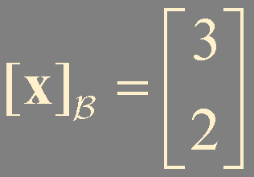
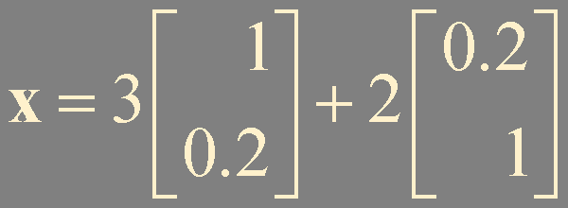
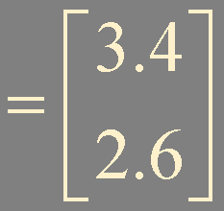
Example 4. What is x?
x
b₂
b₁

Slide 14
Example 5. Could ℝ³ possibly contain a four-dimensional subspace?
a basis of four linearly independent vectors
impossible

Slide 15
Summary
Coordinate systems
Dimension
Rank
Invertible Matrix Theorem

